Slide 1

Color Image Processing
Dr. Héctor Gabriel Acosta Mesa
Instituto de Investigaciones en Inteligencia Artificial
Maestría en Inteligencia Artificial
heacosta@uv.mx
www.uv.mx/heacosta
Image Analysis
© R. C. Gonzalez & R. E. Woods, Digital Image Processing, 2nd ed. www.imageprocessingbook.com

Slide 2
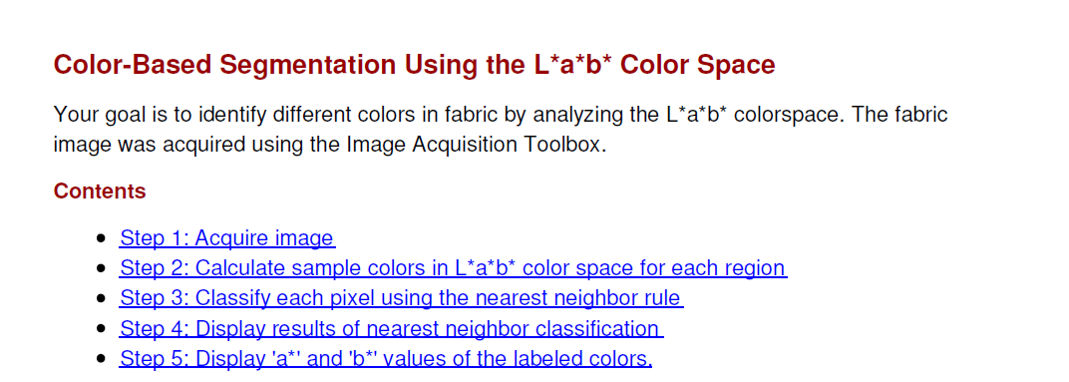
Color-Based Segmentation
Check file: CieLabExample

Slide 3
Excercise
Modify the code Classify_Lab in order to replicate results using RGB and HSV color spaces. Compare results.
Using the image fabric.png in CIELab color space, develop a cluster analysis using k-means* algorithm with k = 6. Reconstruct the image using the proper labels. Repeat the process 5 times and compare your results.

